Slide 1
Programming Languages
John Kim, Rafael Jimenez

Slide 2
Outline
History of programming languages
Languages used in Data Science
Coding examples

Slide 3
History of programming languages

Slide 4

Characteristics
A language is a complex system of communication, spoken or written, verbal or non-verbal.
Semantics: meaning and interpretation of words, signs, and sentence structure
Syntax: rules that govern the ways in which words combine to form phrases, clauses, and sentences

Slide 5


Natural language
Computer language
Developed as part of human evolution
Used to express emotions, sensations, ideas, etc.
Written and spoken
Relaxed
Artificially created
Used to communicate with the computer’s hardware
Written
Strict

Slide 6
How do we communicate with computers?

Slide 7

Path to the computer’s hardware
High Level Language
Assembly Language
Machine Language
Hardware

Slide 8

Machine Code
Binary language that is easily understood by computers
Can be directly executed by CPU with no need of compilers and interpreters
Machine instructions are not human-readable
Differs from platform to platform
0110100001100101011011000110110001101111

Slide 9
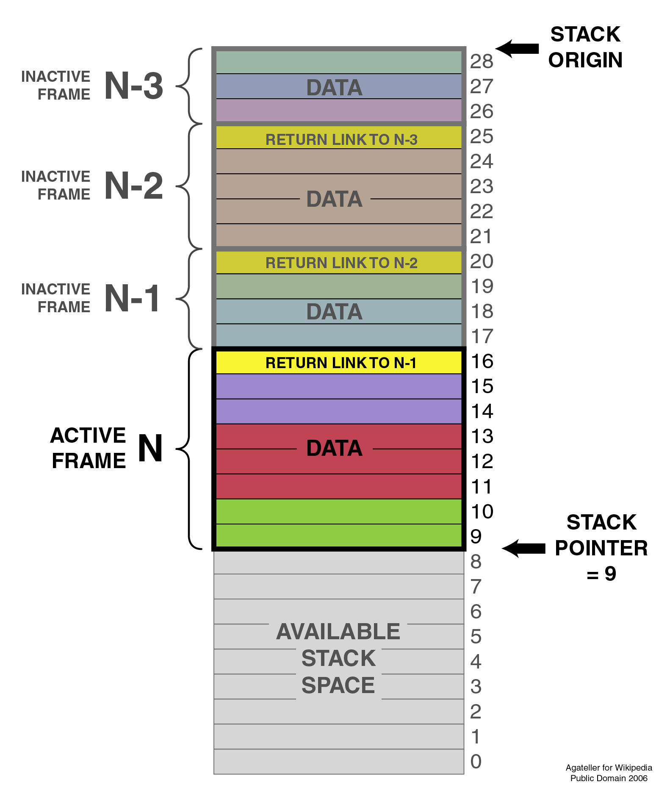
Assembly Code
A first step away from pure binary or machine code
Made use mnemonic devices as representation for binary instructions
Uses more complex numeral systems (hexadecimal, decimal, octal)
Is converted into executable machine code by a utility program referred to as an assembler
Each assembly language is specific to a particular computer architecture

Slide 10
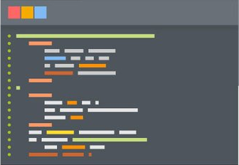
High-level programming
Has strong abstractions from the details of a computer
Easy for programmers to write as well as to understand
Independent of computer architecture
Uses elements from natural language
The amount of abstraction provided defines how "high-level" a programming language is
Susceptible to the concept of abstraction penalty

Slide 11
Assembly code
Python code
.globl main
.type main, @function
Main:
pushq %rbp
movq %rsp, %rbp
movl $10, -8(%rbp)
movl $15, -4(%rbp)
movl $0, %eax leave ret
x, y = 10, 15

Slide 12
Timeline of some high-level languages
Fortran
1957
Cobol
1959
Basic
1964
C
1969
Java
1995
Python 1991
C++
1983
Pascal
1970

Slide 13
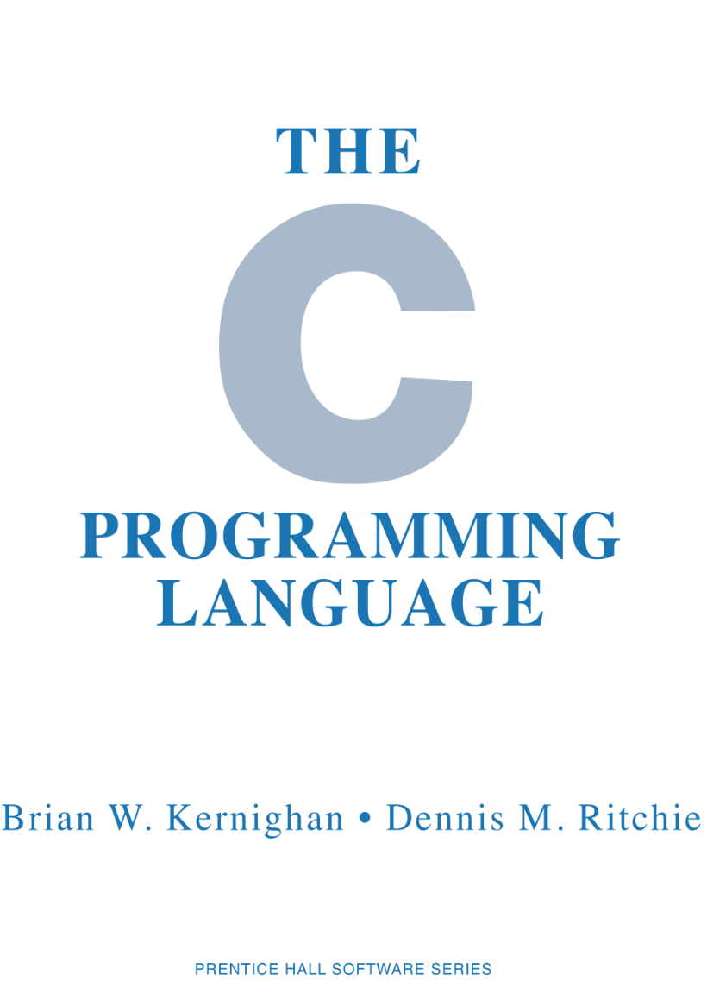
The importance of the C programming language
Considered to be a middle level language
Provides access to some fundamental low-level concepts
Easy for other languages to communicate with
Highly efficient
Forces you to think harder and deeper about what’s happening under the hood
Most modern operating systems and programming languages are written in C

Slide 14
Common languages used in Data Science

Slide 15

R
Programming language and free software environment for statistical computing
Has local communities worldwide for users to network, learn, share ideas and develop libraries
Contains a sea of packages that appeal to all the forms of disciplines like astronomy, biology, mathematics, physics and others
Used for performing complex statistical modeling
Facilitates database interaction

Slide 16

Python
Interpreted, high-level, general-purpose programming language
Provides great functionality to deal with mathematics, statistics and general scientific functions
Has a vast selection great libraries and great community support
Is an expressive language which is possible to embed into applications to offer a programmable interface
It can be ported to more sophisticated languages such as Java or C if necessary

Slide 17
Is one better than the other?

Slide 18
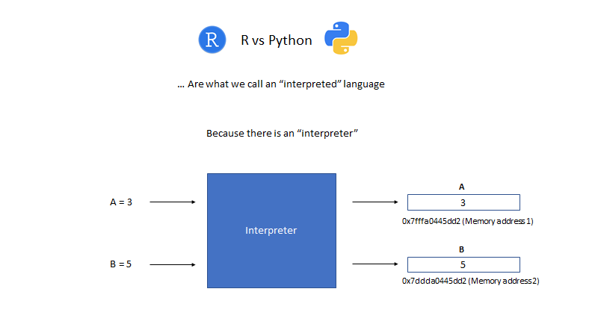
R
Python

Slide 19
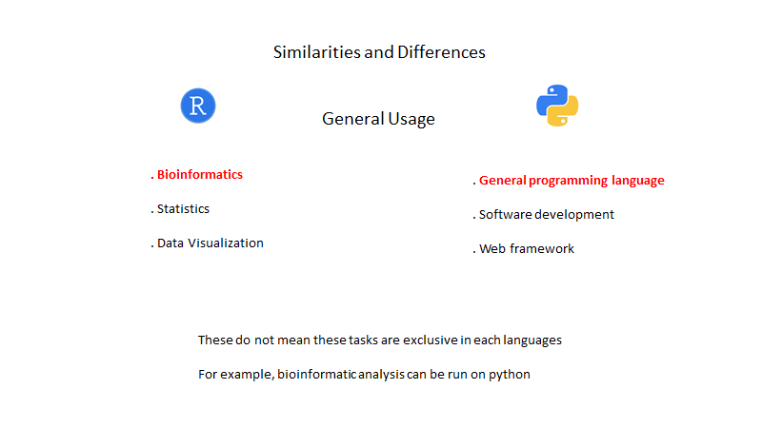

Slide 20
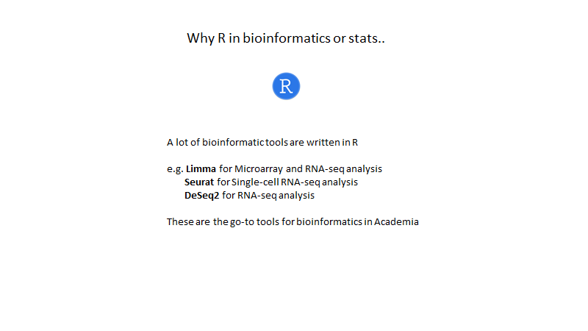

Slide 21
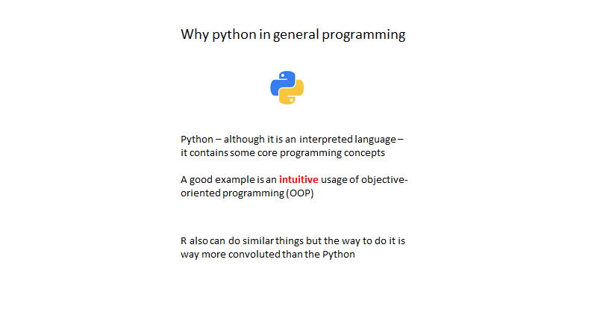

Slide 22
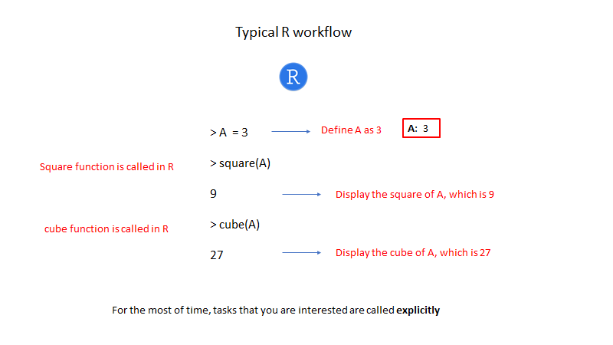

Slide 23
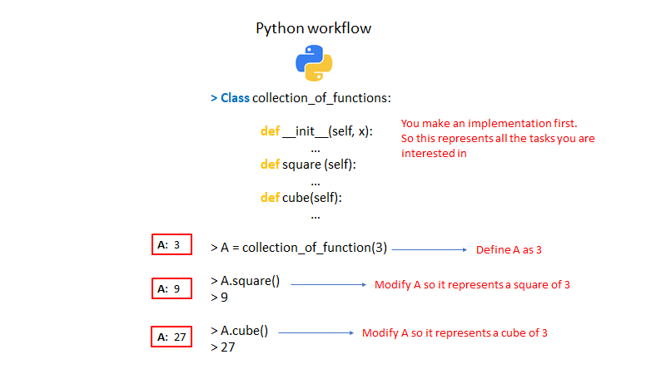

Slide 24
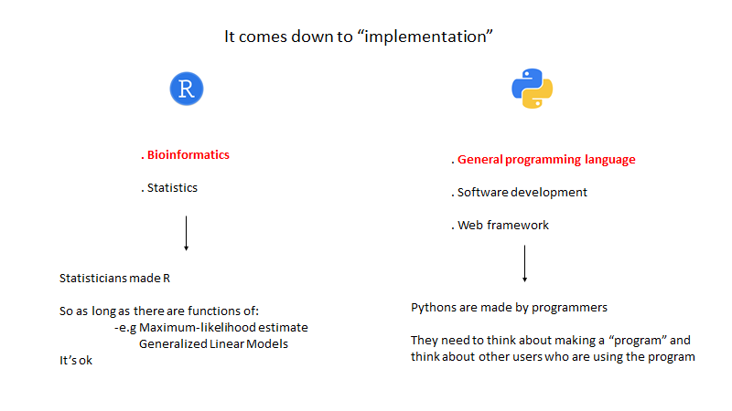

Slide 25
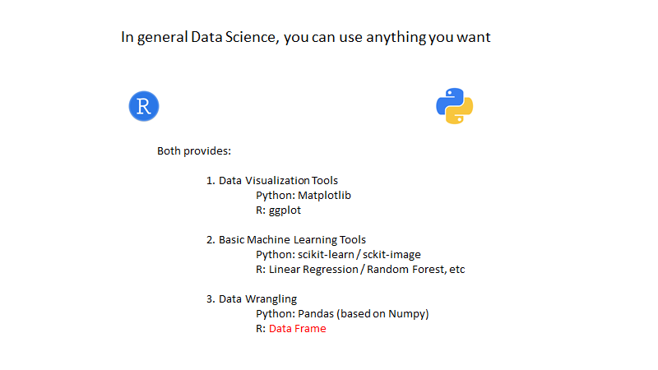

Slide 26
